Slide 1
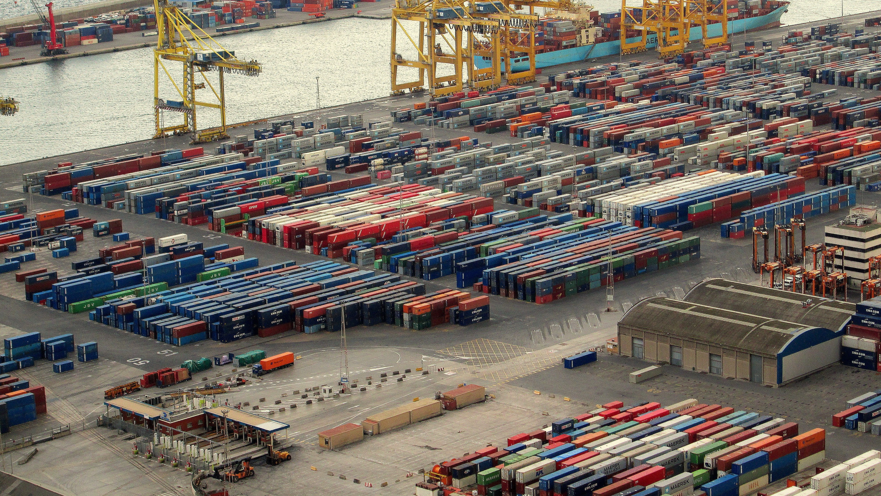


Volume of trading in Saudi Arabia
Ahmad Abusabaeen
3/5/2021

Slide 2
How much has the Saudi economy been affected by covid-19?
State the main take-home message at the beginning of your talk.
Exports:
Lowest in 2020 since 2011
Lowest income?
Imports:
The market became less busy?

Slide 3
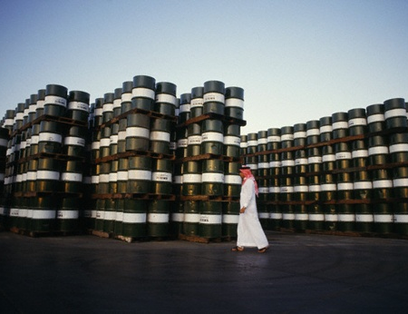

Introduction
What is the main thing you want us to remember about your talk?
What does Saudi Arabia export the most?
What is the ratio of oil exports to non-oil exports?
This Photo by Unknown Author is licensed under CC BY

Slide 4
Why Saudi Arabia?
Member of G20 (Group of twenty world’s leading economies)
Member of OPEC (Organization of the Petroleum Exporting Countries)
World’s second largest reserves of oil.
Strategic location (Asia, Africa, and Europe)

Slide 5

Outline
Introduction
Volume of Saudi exports
Top Saudi exports
Volume of Saudi imports
Top Saudi imports
Statistical Trends
Conclusion
This Photo by Unknown Author is licensed under CC BY-NC-ND

Slide 6
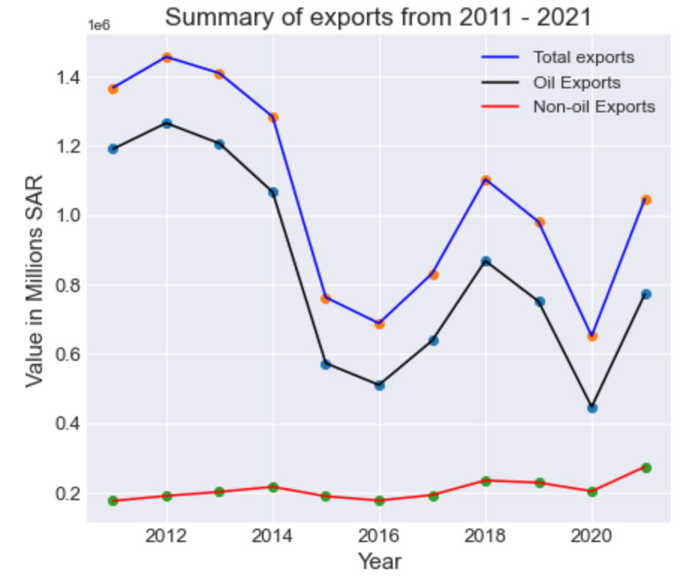
Volume of Saudi exports
Total exported from 2011- 2021 (SAR 11,586 B)
Oil exports %80 (SAR 9,294 B)
Non-Oil exports %20 (SAR 2,292 B)
Notes:
How much does the oil exports add to the Saudi economy?

Slide 7
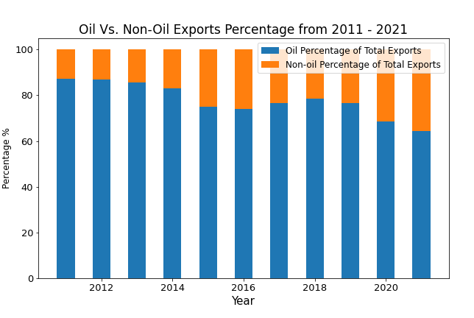
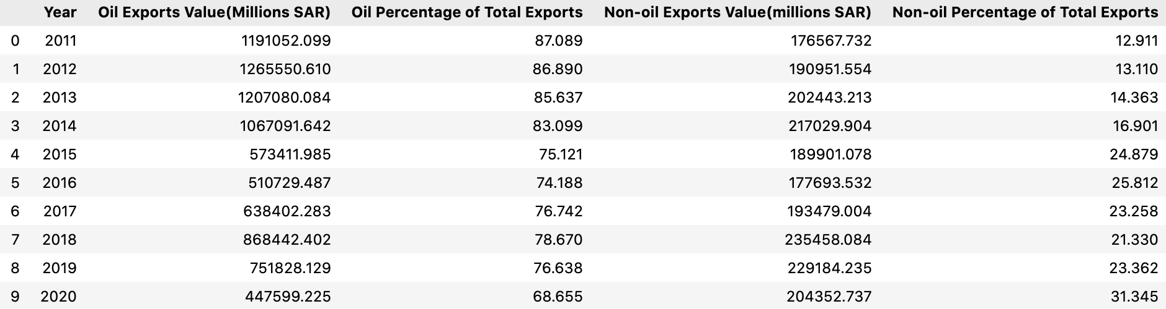
Top Saudi exports
Oil
Oil exports %80
Big drop of oil exports VALUE after 2014
Notes:
Starting to recover in 2018

Slide 8
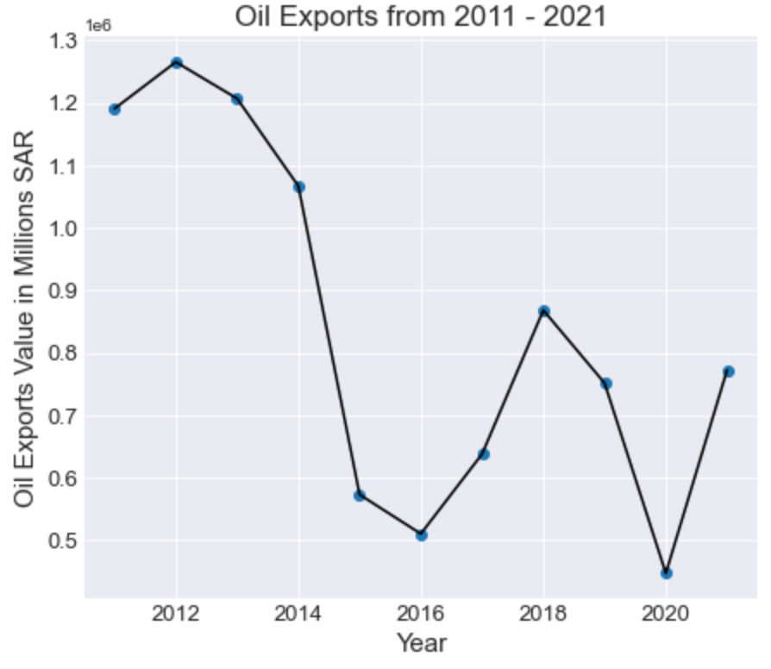
Oil Exports
Highest (2012) = SAR 1265.6 B
2012 Average Price = $ 94
Mean = SAR 1054 B
Lowest (2020) = SAR 652 B
2020 Average Price = $ 40

Slide 9
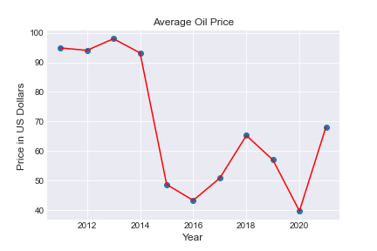
Oil Price
Highest Average Price = 2013 ($ 98)
Lowest Average price = 2020 ($40)

Slide 10
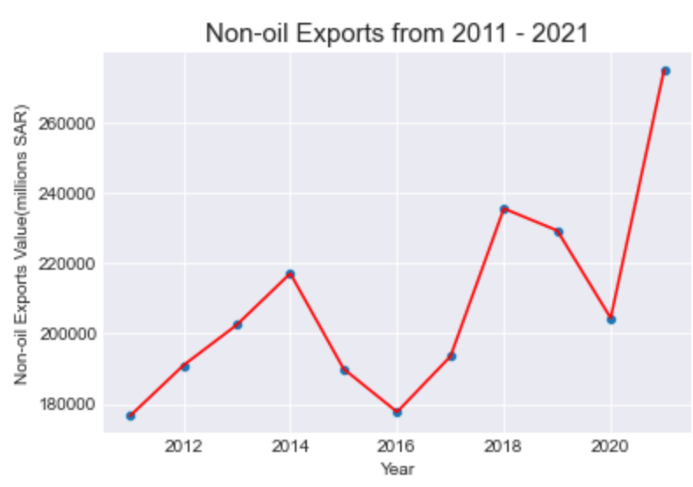
Non-Oil exports
2011 – 2021 Total = SAR 2292 B
2016 = SAR 178 B (Lowest)
2019 = SAR 229 B
2020 = SAR 204 B
2021 = SAR 275 B (Highest)

Slide 11
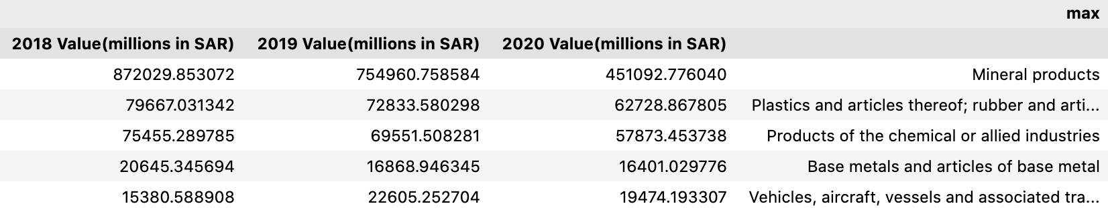
Non-Oil exports
Are the non-oil exports increasing?
Not crude oil, but some are affiliated to oil
Mean= SAR 201,706 m
2018 = SAR 235,458 m
Since 2018:
Mineral Products (percentage of overall in the years)
Plastics
Chemicals

Slide 12
Volume of Saudi imports
Sum of imports
2021 = 578,141 m SAR
2020 = 517,491 m SAR
2019 = 574,361 m SAR
2018 = 513,992 m SAR

Slide 13
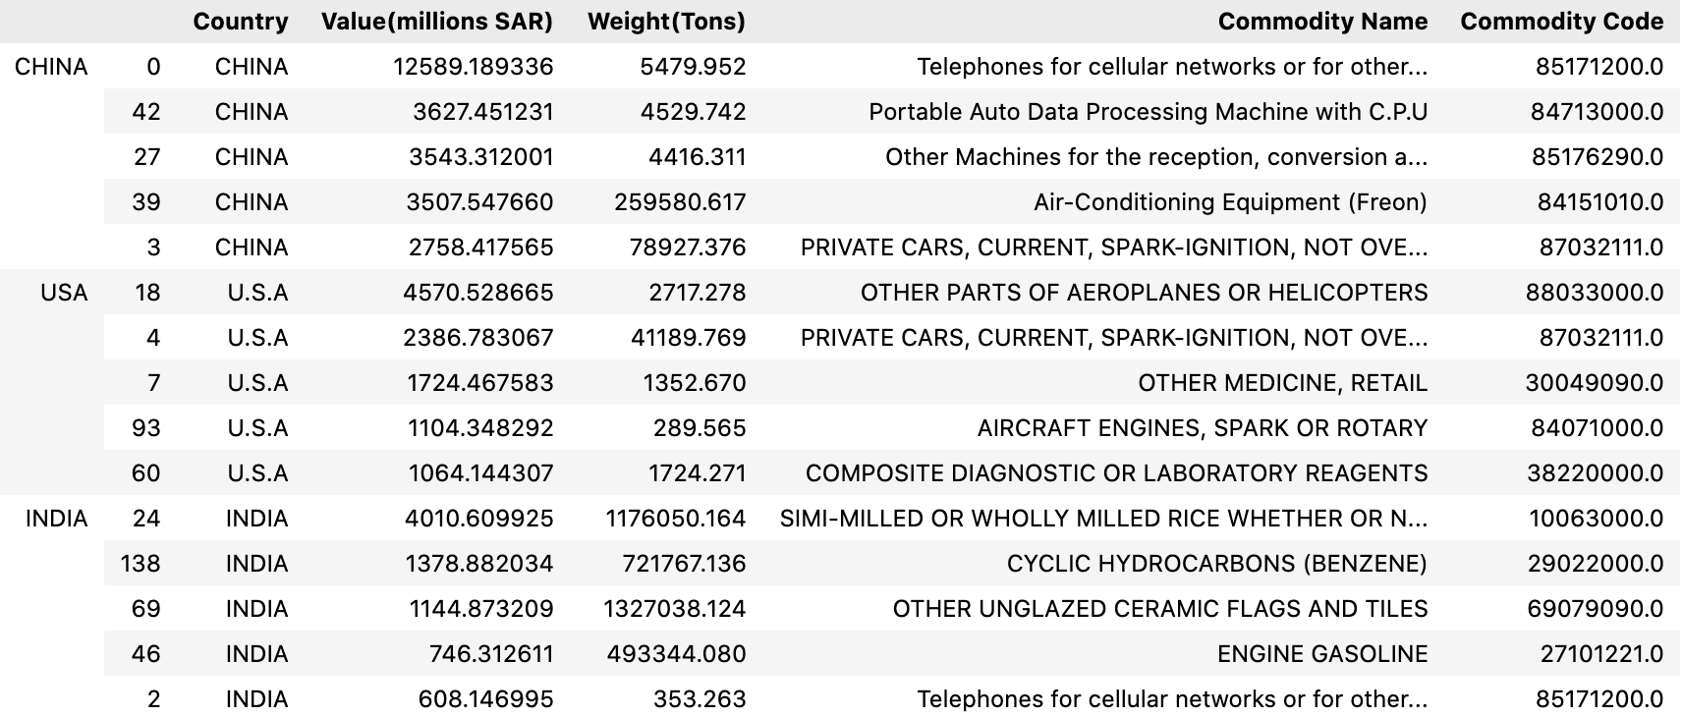
Top Saudi imports in 2020
By Tons:
China, United States, and India

Slide 14
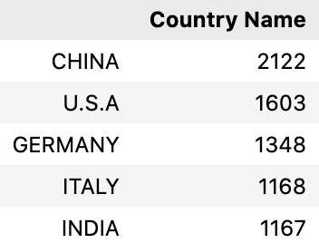
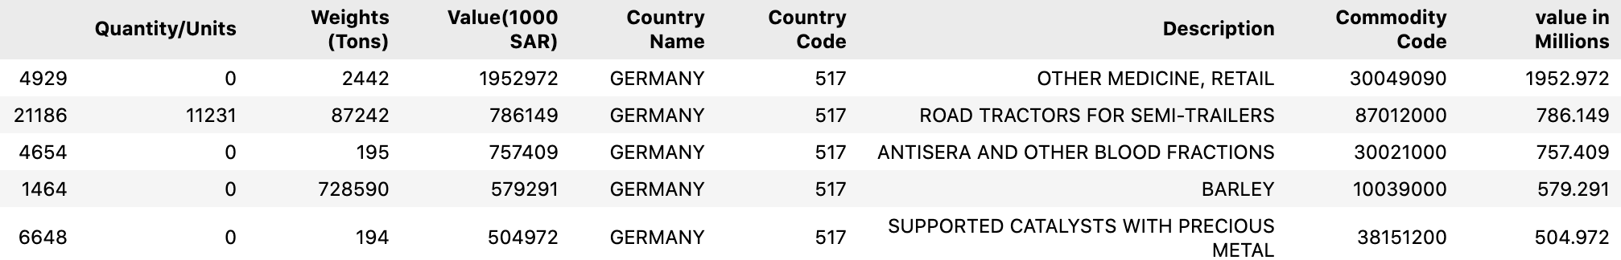
Top Saudi imports in 2020
By number of Commodities:
China, United States, and Germany

Slide 15
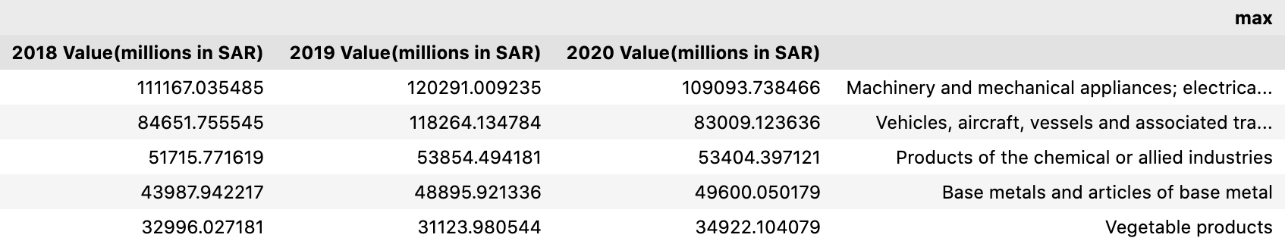
Top Saudi imports 2018-2020
Sum of imports
2018 Value(millions in SAR) 513992.690199
2019 Value(millions in SAR) 574361.454604
2020 Value(millions in SAR) 517490.594270

Slide 16
Statistical Trends
Non-oil exports in 2021 highest since 2011!
SAR 274.9 B

Slide 17
Covid-19 Effect on exports & imports

Slide 18
Problems encountered
Not uniformed data, such as sheets, values, and language

Slide 19
Conclusion
Thank you!

Slide 20
References
https://www.datacamp.com/community/tutorials/joining-dataframes-pandas?utm_source=adwords_ppc&utm_medium=cpc&utm_campaignid=1455363063&utm_adgroupid=65083631748&utm_device=c&utm_keyword=&utm_matchtype=&utm_network=g&utm_adpostion=&utm_creative=332602034358&utm_targetid=aud-299261629574:dsa-429603003980&utm_loc_interest_ms=&utm_loc_physical_ms=9076782&gclid=Cj0KCQiA64GRBhCZARIsAHOLriJSD4EDpEONsNz2t5vVxJNO_KPls4ktLMUG84pZq5K2n9SgY_AgZ1gaAphnEALw_wcB
https://www.opec.org/opec_web/en/about_us/169.htm
https://www.state.gov/u-s-relations-with-saudi-arabia/
https://www.macrotrends.net/2516/wti-crude-oil-prices-10-year-daily-chart

